Slide 1
Lecture 3.0: Signaling

Slide 2
Introduction
Signaling is used between the user and the network or between two network elements to exchange various control information like:
    Traffic Descriptors
    Service Descriptors
    Channel Identifiers
In other words, Signaling is used to dynamically establish, monitor, and release connections (including physical, virtual and logical connections)

Slide 3
Examples
Connection setup request
    Off-hook signal from telephone to switch
Connection setup acknowledge = Dial tone
Destination address = Pulse or tone dialing
Destination busy = Busy tone
Destination Available = Ringing tone

Slide 4
Signaling Standards
Q.931 = Basic Call Control for ISDN
Q.932 = Extends/uses Q.931 for supplementary services (call forwarding, etc)
Q.933 = Q.931 Extension/subset for Frame-relay
Signaling inside the network is more sophisticated than that between the network and the subscriber
Digital Subscriber Signaling System 1 (DSS1)
    Call control signaling over the D channel
    Q.931 + Q.932 + lower layers
Signaling System 7 (SS7) deals with inside the network while DSS1 deals with outside.
Q.2931 = Q.93B = Basic Call Control for B-ISDN

Slide 5
Signaling in Telecom Network
Traditionally, the use of signaling in Telecom Networks was the bare minimum.
It was restricted to establish/release a voice channel to allow telephonic conversation.
For e.g., SS7 which has an advanced network architecture, provides feature-rich signaling

Slide 6
Signaling in
Virtual-Circuit-Based Network
If Permanent Virtual Circuits (PVCs) are established, generally, no signaling is required.
For Switched Virtual Circuits (SVCs), signaling takes place using a well-defined signaling protocol.
For e.g., Q.2931/Q.2971 (signaling protocol for ATM) is much more complicated vis-a-vis Q.933 (signaling protocol for frame relay).

Slide 7
Signaling in Datacom Network
Datagram networks, generally, do not require signaling. This is because, by definition, a connectionless network does not entail connection setup.
To provide QoS, some resource reservation and, hence, some form of signaling is required.
For e.g., the protocols like MPLS and RSVP require some form of signaling message exchange and resource reservation.
Notes:
MPLS: Multiprotocol Label Switching (MPLS) is a label switching technology that provides the ability to set up connection-oriented paths over a connectionless IP network. MPLS facilitates network traffic flow and provides a mechanism to engineer network traffic patterns independently from routing tables. MPLS sets up a specific path for a sequence of packets. The packets are identified by a label inserted into each packet.
RSVP: Resource Reservation Protocol (RSVP) RSVP-TE is a signaling protocol and an extension of RSVP. RSVP-TE uses a soft state to manage its resource reservation states. This means we have to periodically send refresh messages to maintain the state information in routers along the path of our TE tunnel.

Slide 8
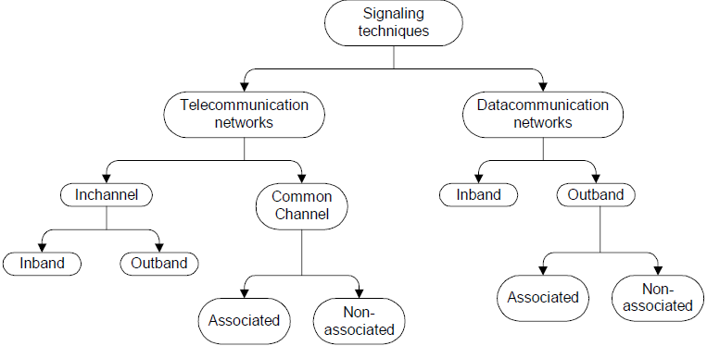
Signaling Channels and Techniques

Slide 9
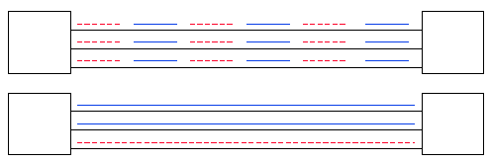
Signaling Channel
In-band signaling ⇒ Signaling over the same channel as the payload
Out-of-band signaling ⇒ Separate channels for signaling (but maybe the same physical circuits)
Common Channel Signaling (CCS)
    Separate circuits for signaling
    Allows several new functions, such as 800

Slide 10
Inband versus Outband Signaling
Telecom Network:
In-band signaling refers to using the same voice frequency band to carry signaling information as that used to carry voice (i.e., 300-3400Hz).
In contrast, out-band signaling refers to using frequencies above the voice band (but below the upper threshold of 4000Hz) to carry signaling information

Slide 11
Datacom Network:
Inband signaling refers to using the same virtual channel to carry signaling information that is used to carry data.
In contrast, in Outband Signaling the signaling information and data are carried on different virtual channels.

Slide 12
Inchannel Signaling versus
Common Channel Signaling
Telecom Network:
In-channel signaling, the same physical channel carries signaling information as well as voice and data.
In contrast, Common Channel Signaling uses a separate channel for solely carrying signaling information for a number of connections.

Slide 13
Datacom Network:
To some extent, in-channel signaling and common channel signaling in telecommunication networks are analogous to in-band signaling and out-band signaling in data communication networks, respectively.

Slide 14
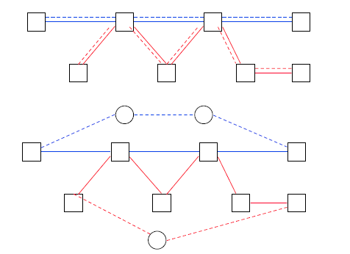
Signaling Modes
Associated Modes: Common Channel Signaling (CCS) follows the same path as the payload
Nonassociated Modes: Common Channel Signaling (CCS) uses a separate network

Slide 15
Associated Signaling versus
Non-Associated Signaling
Telecom Network:
Both these techniques are variants of Common Channel Signaling
In Associated signaling, the signaling channels and the data paths pass through the same network elements.
In Non-associated signaling, there is no correspondence between signaling channels and data paths.

Slide 16
Datacom Network (for ATM):
In Channel associated signaling, all the signaling messages for each VPI is exchanged on VCI=5 of that virtual path
In Channel non-associated signaling, all the signaling messages of all the virtual paths are exchanged on VPI=0 and VCI=5.
Notes:
VPI : Virtual Path Identifier
VCI: Virtual Connection Identifier

Slide 17
MetaSignaling
Another technique metasignaling finds mention in various signaling standards
Metasignaling refers to the process of establishing signaling channels using signaling procedures.
Used to setup signaling channels.
All meta-signaling messages are one cell long and have VPI/VCI = 0/1

Slide 18
Cont.
It Sets up 3 types of signaling channels:
    Point-to-point
    General broadcast
    Selective broadcast
Procedures to:
    Set up new signaling channels
    Release channels
    Verify channels

Slide 19
Signaling Issues
Acknowledgements
Timer protection
Parameter negotiation
Call/Connection identification
Finite state machine modelling
Message encoding and decoding (TLV format)

Slide 20
Acknowledgements
Required due to unreliable nature of transmission media.
The classical two-army problem suggests that no scheme can provide full-proof acknowledgement for an unreliable media.
However, 2 or 3 handshakes is typically sufficient for a normal case.

Slide 21
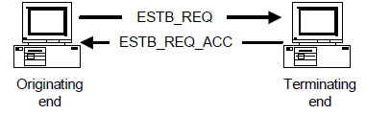
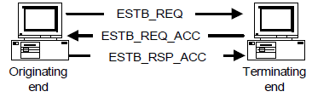
Cont.
Two Way Handshake
Three Way Handshake

Slide 22
Timer Protection
Timers are used to avoid inordinate delays in case the signaling messages get lost or corrupted.
Timer is started after message transmission.
In case message is lost or discarded, the timer expires and message is retransmitted.
In case message is lost or discarded, the timer expires and message is retransmitted.

Slide 23
Cont.
Choosing the correct timeout value is important.
  If this value is too small, then timers will timeout very frequently.
  If a very large value is chosen, it may defeat the purpose of keeping timers.
  Typical value is twice the round-trip propagation time.

Slide 24
Parameter negotiation
This entails arriving at a common set of parameters.
The nature and scope of parameter negotiation depends on the number of handshakes.
In a two way handshake, negotiation is bare minimal.
A three way handshake provides more scope for negotiation.

Slide 25
Call/Connection identification
Consider the following steps:
  An end-system ‘A’ sends a connection establishment request to ‘B’
  ‘A’ sends another request to end-system ‘B’ for connection establishment
  ‘A’ then receives a reply from ‘B’. How does ‘A’ identify to which request has ‘B’ replied to?
The solution is to generate a uniq_num and accompany it with every message

Slide 26
Finite State Machine (FSM)
A Call goes through three phases
  Call establishment
  Data transfer
  Call releasing
The FSM accepts messages only if the message is permitted in that state.
The state change happens when 1) a message is received from peer, 2)Timer expires and 3) User Request.

Slide 27
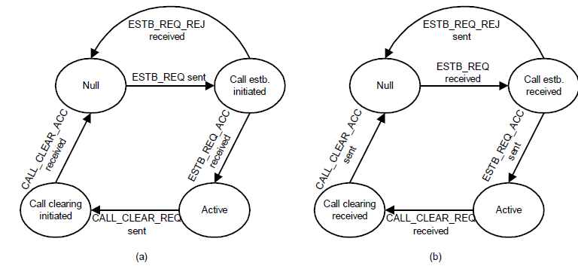
Finite State Machine (FSM) (2)

Slide 28
Encoding/Decoding
Generally, messages are encoded in Type-Length-Value (TLV) format.
  Type: Identifies the type
  Length: Length of message (total length or length excluding the header)
  Value: The actual contents
Information blocks within the message may also be encoded in TLV format

Slide 29
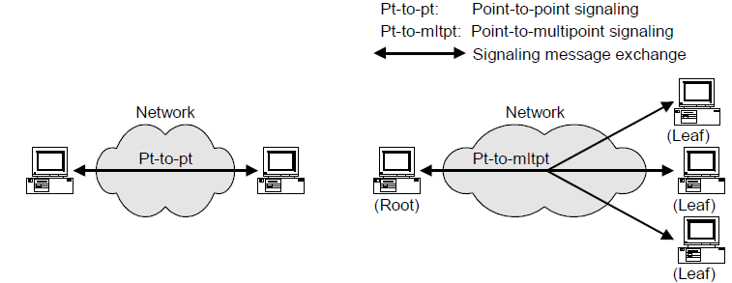
Signaling Models

Slide 30
Point-to-Point Signaling
Point-to-Point signaling model is used to establish and release connections between two end-points.
The is the most common model of signaling.
Not only is this model popular, it is also very simple to implement.

Slide 31
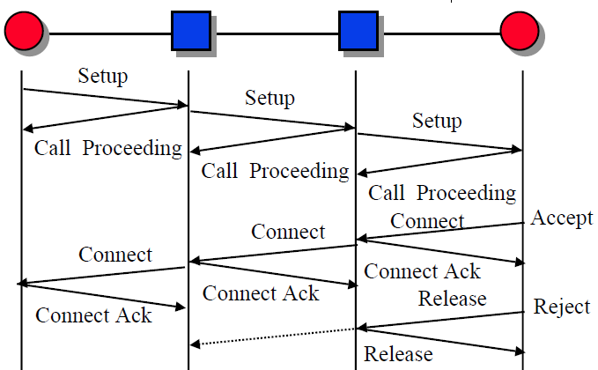
Connection Setup

Slide 32
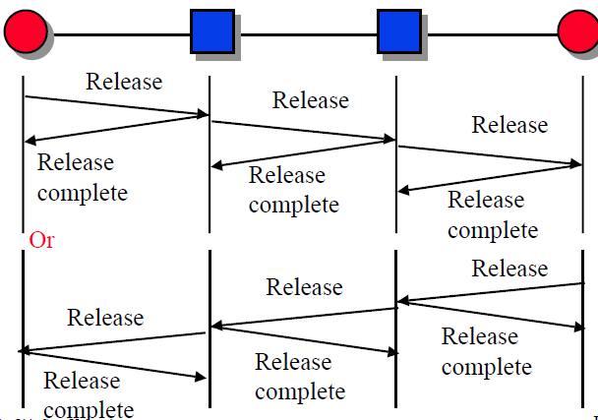
Connection Release

Slide 33
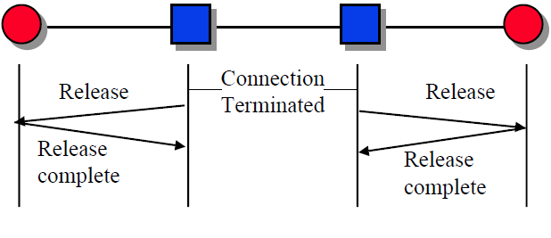
Connection Release (cont)

Slide 34
Point-to-MultiPoint (PMP) Signaling
Point-to-MultiPoint signaling model is used to establish and release connections between a root and multiple end-points.
This form of signaling is mainly used for multicasting or broadcasting applications (e.g., distant learning).

Slide 35
Starting a PMP call
A PMP call is generally started by the root.
  The root may take this step voluntarily,
  Or, it may do the same after receiving an explicit request from a leaf.
  The leaf can send the connection establishment request to the root through signaling channel or through other means.
The first connection is established following point-to-point procedures.

Slide 36
Adding parties to a PMP call
After a PMP call is established, parties are added by the root.
The root is informed either through a signaling message, or through some other means.
Subsequent parties have no say in determining the parameters of the connection, as it has already been fixed

Slide 37
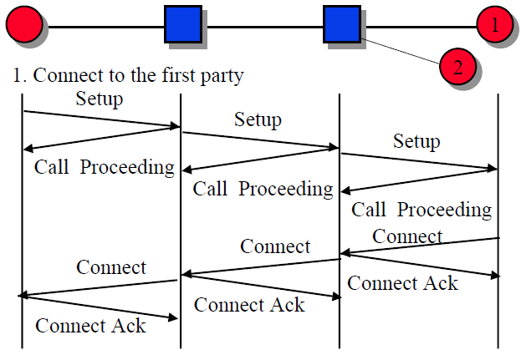
Multipoint Connection Setup

Slide 38
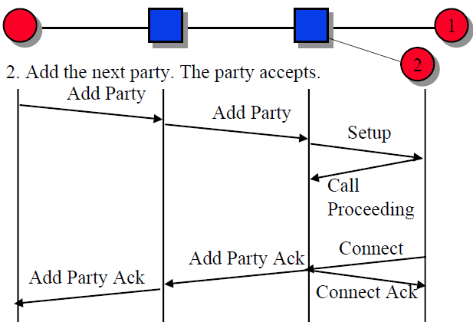
Multipoint Connection Setup (cont)

Slide 39
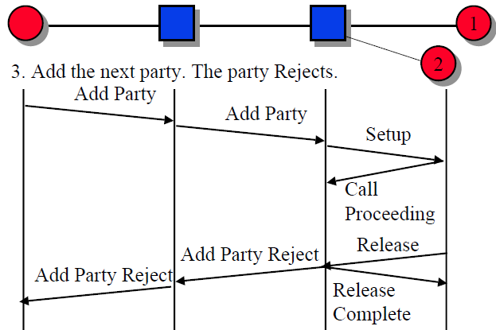
Multipoint Connection Setup (cont)

Slide 40
Dropping parties and releasing a PMP call
A leaf of a point-to-multipoint call can drop itself out of the connection by sending a message to the root.
It is mandatory for the root to entertain this request, and drop that particular party.
If the root drops itself out of the connection, the whole connection is cleared.

Slide 41
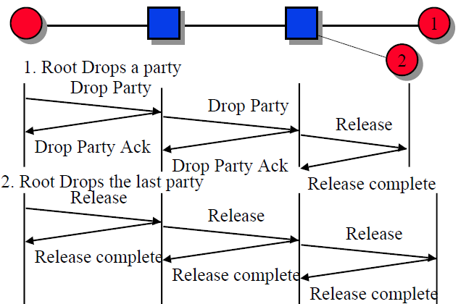
Multipoint Connection Release

Slide 42
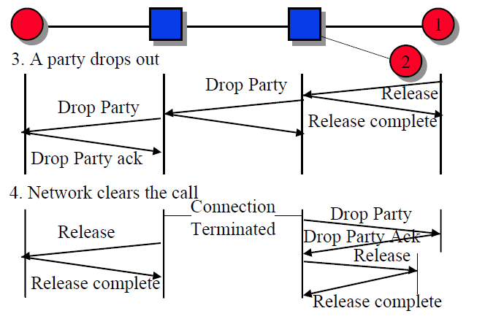
Multipoint Connection Release (cont)

Slide 43
Nature of a PMP call
By definition, a PMP call is one in which the data flows from the root to the leaves (i.e. unidirectional in nature).
Theoretically, nothing precludes bidirectional data-flows in PMP calls.
However, if leaves are allowed to send data to the root, there is a multipoint-to point connection along with the point-to multipoint call.

Slide 44
Adv/Disadv of a PMP call
Advantages
  Saving of network resources like bandwidth. The % saving depends upon the breadth and the depth of the PMP tree.
Disadvantages
  PMP connections are difficult to establish, manage, and release.
  It is not easy for the leaves to indicate the root to start a connection.
  The unidirectional nature

Slide 45
Thank You!

